Slide 1
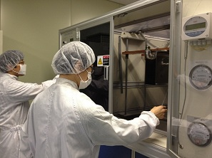
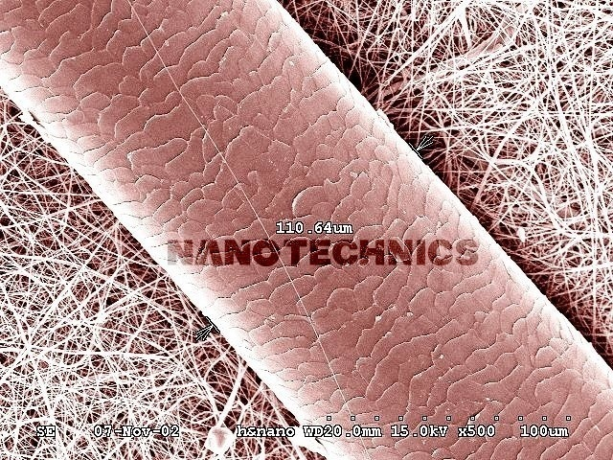
The Latest up-graded Nano Fiber Tec. &
It’s new applications.
1

Slide 2
What is The “Electro-Spinning”?
Definition: Process that produces a highly impermeable,
non-woven fabric of submicron fibers by pushing
a millimeter diameter liquid jet through a nozzle
with an electric field after making a polymer solution
(fibrillation of polymer)
Ex) Electro Melt spinning & blown: 0.001~0.00001mm
Dry spinning Fiber : 0.5~1.0mm
2

Slide 3
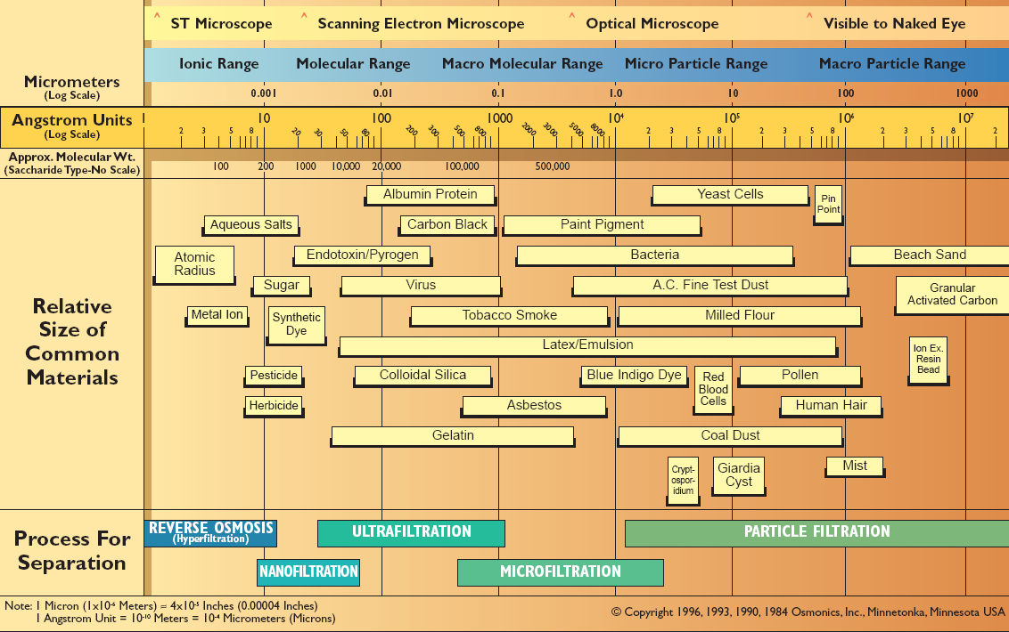
The World of Micro & Nano Size
3

Slide 4
Market Prospect of Nano Industry.
Possible to expand to the wide application beyond previous materials.
Growth rate 10% since 2009, Market scale will be 40 billion by 2030 year..
Main market will be energy storage and filter materials..
< Prospect of world-wide nano Fiber-market >
(unit : o.1 BU$)
Medical
3.8%
Filters
20.6%
CAGR 22.7%
CAGR 22.7%
40 B U$
(2030)
Energy Storage
44.0%
Coated Fabrics
5.5%
Energy Storage
44.0%
Cleaners
5.1%
Extremity-environmental
Materials 16.5%
Carbon Fiber
4.5%
4

Slide 5
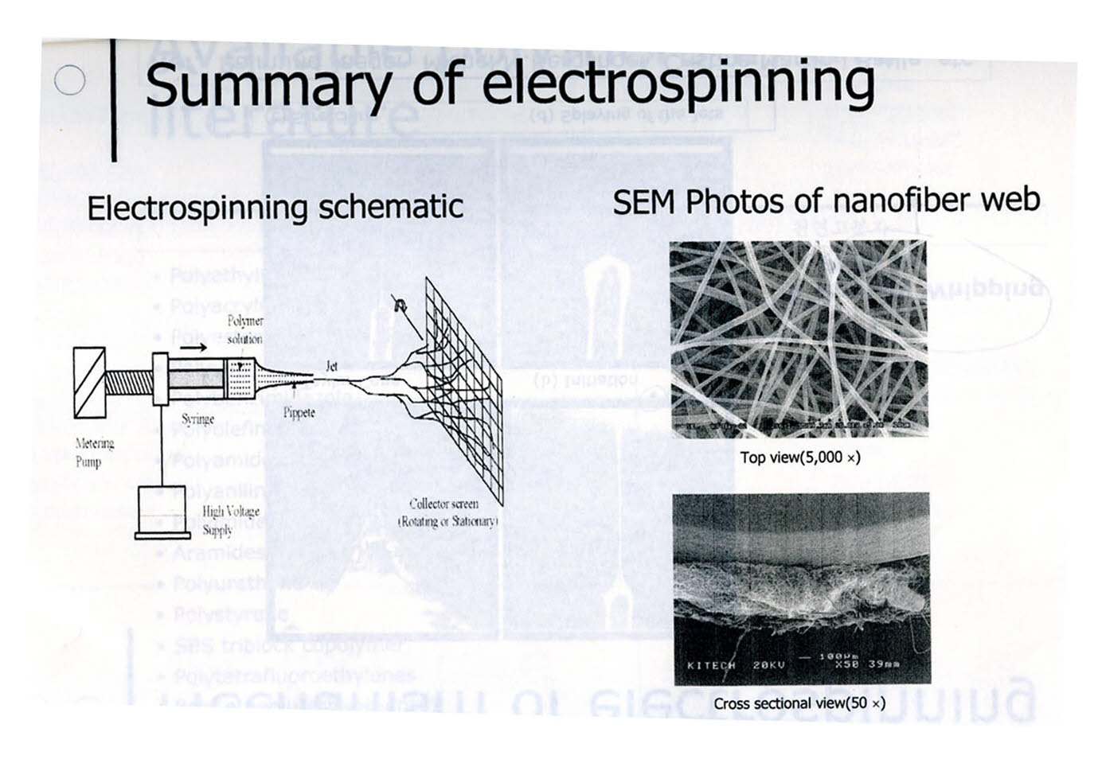
Simple Drawing of E/S
Electro-static polymer sosolution
5

Slide 6
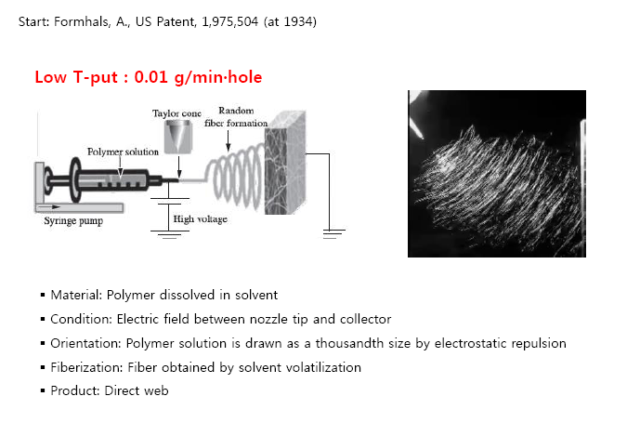
  Origin of Electro-Spinning Tech.
6

Slide 7
AVAILABLE POLYMERS IN ELECTRO-SPINNING
& ITS SOLVENT
PAN (Poly acrylonitrile) ; DMF –(Hydrophobic)
Cellulose; NMMO:Normal Methyl Morpholine N-Oxide)-Applicated for Tire code
Polyimide; PHENOL(Heat resistant)
Polyamides & Poly aramide : SULFURIC ACID(Heat-resistant)
Poly aniline : SULFURIC ACID(Conductive)
PU (Polyurethane) : DMF(Elastics and Adhesive)
PVA (Poly viny lalcohol) : WATER solubility
PVC, PVDF : DMF(Frame retardance & Hydrophobics)
The others : Natural polymer, Polypeptides(Protein), Collagen
7

Slide 8
Details of Bio-Polymer and It’s Solvent
Polyimides
Polyamic acid
Polyetherimide
Nylon 6 & Nylon 66
Polyaramid
Poly-benzyl-glutamate
Poly(p-phenylene terephthalamide)
Polybenzimidazole
Ultem 1000 (Polyether imide)
Nylon 6-co-Polyimide
Polyacrylonitrile(PAN)
PVDF
Polypropylene
PLA
PVA
Collagen
Chitosan
Polymer
Phenol
m-cresol
Methylene chloride
Formic Acid
Sulfuric acid
Dimethylformamide
Sulfuric acid
Dimethylacetamide
Chloroform
Formic acid
Dimethylformamide
DMF
Melt in vacuum
DMAc
Water
Water/Acetone
Strong Acid
Solvents
Possibility: CNT with other polymer
Graphene with other polymer
8

Slide 9

Future Trend Of Textile –Fabrics.
Nano Fiber Textile
‘Hybridization & Composite of nano fiber & textile’
: composite functions-Hybrid-textiles, compact..
High Performance
Fiber
‘Smart performance: each functions are revealed by special conditions
Intelligent Textile → Smart & Eco Friendly Fabrics
‘New High Performance’
Composite Textile→ air-permeable & water proof,
→ Anti-baterial etc..
Bio-mimetic textile → Bionic Functional Fabrics
New Synthetic Fibers
Synthetic Fibers
‘Mass production’
softness • Strength, Durability, Chemical-resistance
Natural Fibers
‘Basic Performance’
Strength, Handle, Warmth, Permeability
9

Slide 10
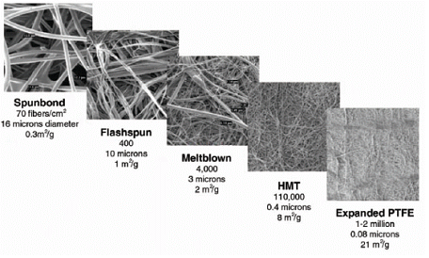
Trend of HMT(Hybrid Membrane Nano Tech) and Micro Fiber
10

Slide 11
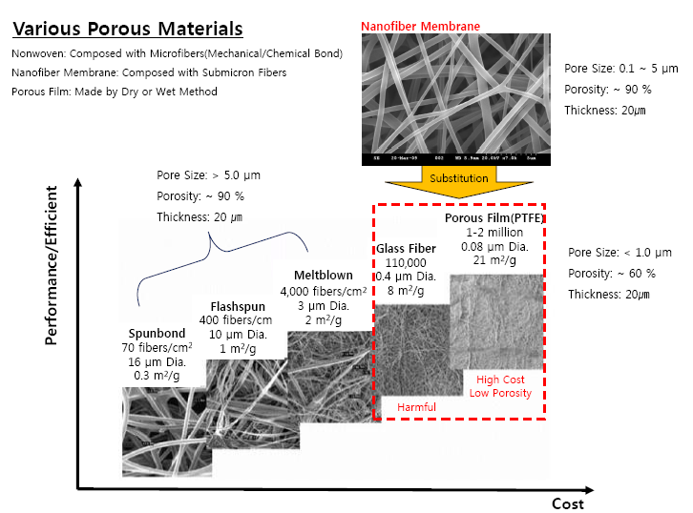
  Position of Nano fiber Membrane
11

Slide 12
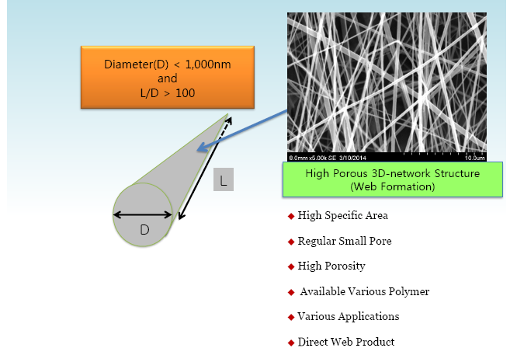
  Features of Nano fiber
12

Slide 13
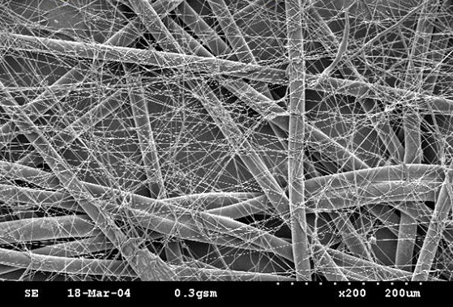
Size Of Nano-Fibers
Nano fiber with P.E.T 2d Spun-bond
Nano-fiber with Hair
13

Slide 14
Surface Area & Pore Size Of Nano-Fibers
14

Slide 15
BASIC PRINCIPLE OF ELECTRO-SPINNING
Drop
HV
Charge
Taylor cone
Jet
Spraying, Splitting, Whipping
Collector
Electrospinning
15

Slide 16
Methods(Patents) of Electro-Spinnings
1
Classical E-spin
2
Multiple Classical E-spin(over 80%)
16

Slide 17
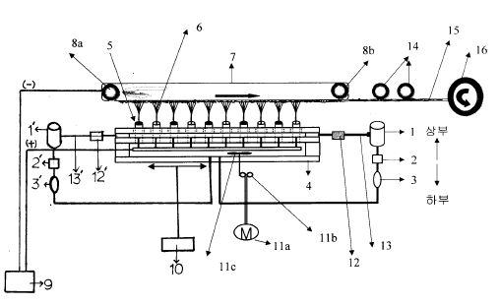
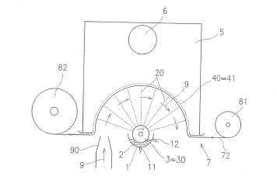
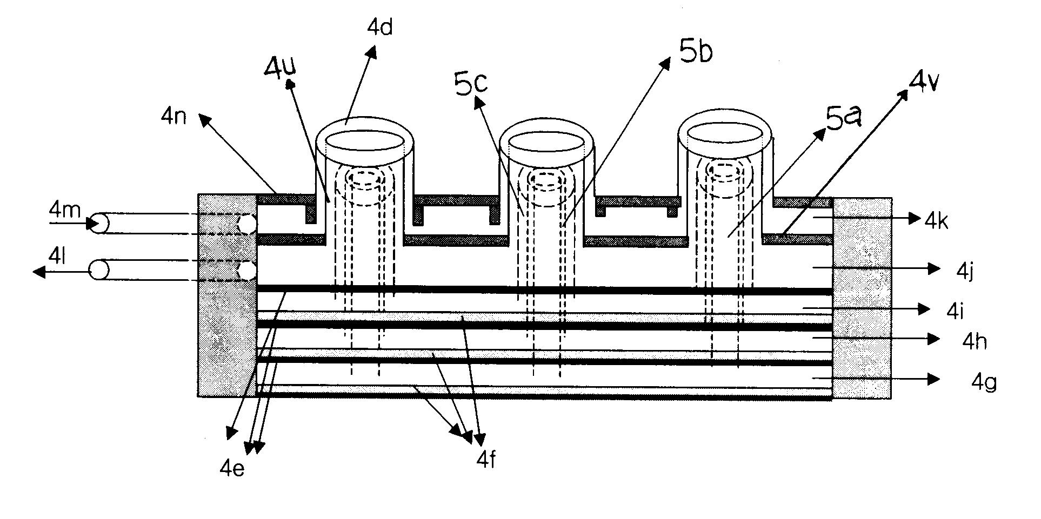
3
Upward type Classical E-spin
4
Rolling type Classical E-spin
5
Rolling type Classical E-spin
17

Slide 18
Modified Electro-blown spinning (E co.- D co.-C co.)
6
18

Slide 19
ELECTRO-SPINNING VS. ELECTRO-BLOWN SPINNING
HV
HV
F co, A co,T co. etc-
D & C Co-
19

Slide 20
Current Status of E/S
Technology
Nano-size’s deviations of M/D & C/D
Needed to be guaranteed
Air/Liquid Filters, Sports Wear, Bio-medical, Battery Separator, etc.
Productivity
Needed multiple nozzles(10,000~30,000) in Mass Production
High Maintenance Cost & expensive fixed cost.
Quality
Unstable Process Control and not uniform Fiber Diameter(~ 1µm)
Various conditions by Various Polymers Applications
20

Slide 21
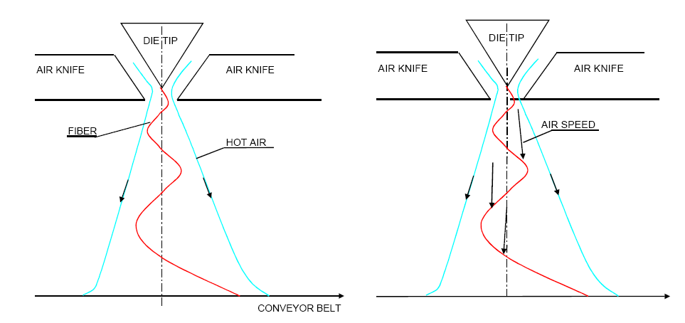
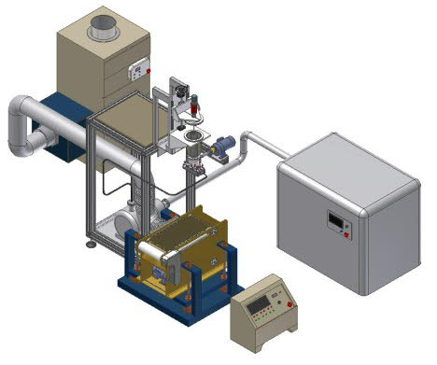

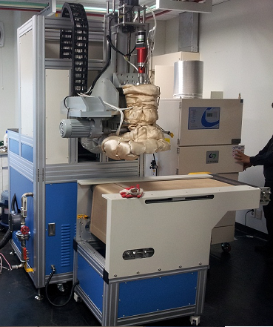
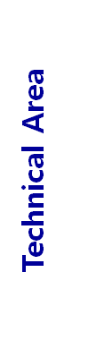
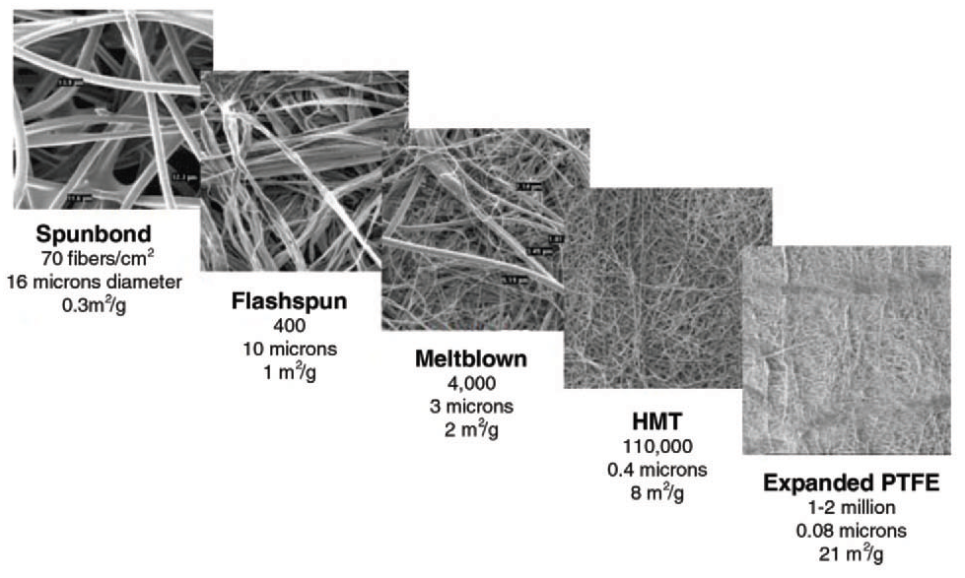
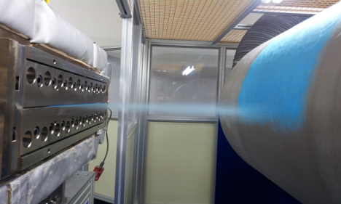
Use of Spunbond& Melt-Blown Technology for making
Hybrid-Nano fibers
Melt-Blown System
Fig. 1 Flying direction of filaments Fig. 2 Stretching of filaments by air speed
Nanofiber
21

Slide 22
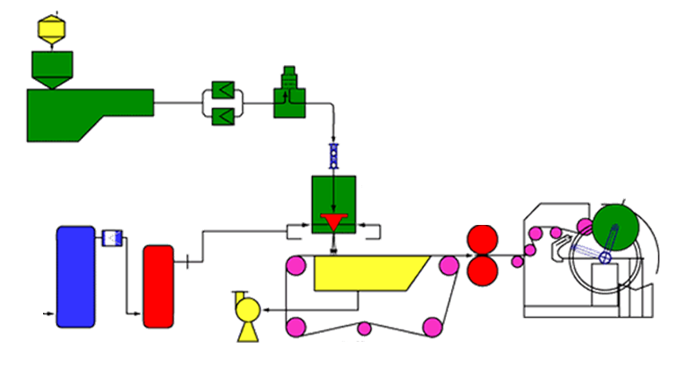
E-Spinning with Spunbond Melt Blown Tech (Hybrid Tech)
Process : SMN PROCESS, SNS PROCESS, SMNS etc...
Eletro -Blown Spinning Technology
Metering Pump
(Gear-type)
Polymer
Filter
Extruder
Spin Block & Nozzle
Hot-Air
Heater
Compressor
Winder Unit
Ring Blower
Suction Collector
22

Slide 23
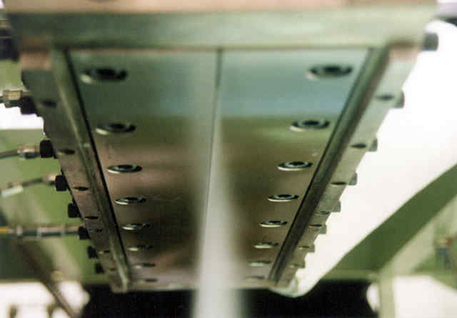
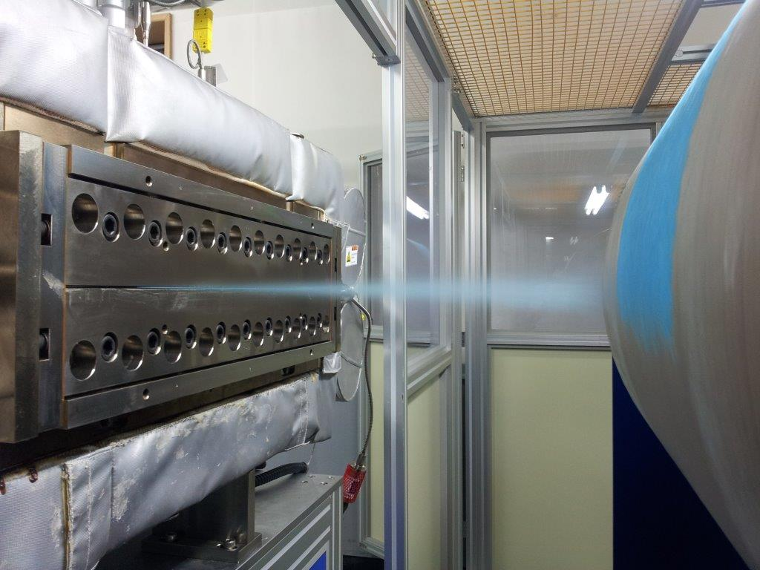
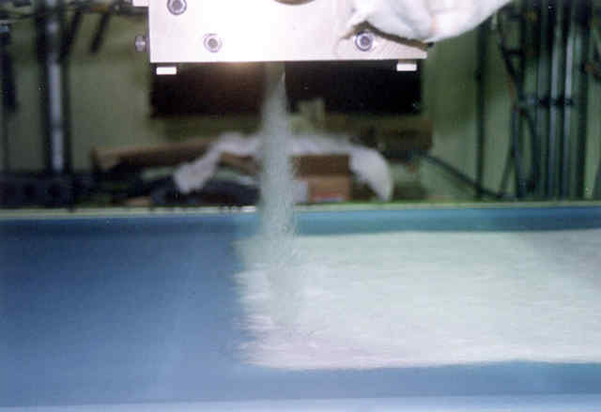
Use of Electro-Melt Blown Spinning
23

Slide 24

Features of E/Blown Spinning.
Fiber
Dry spinning
Wet spinning
Melt spinning
Meltblown
Productivity
Microfiber
Modified melt blown
Islands-in-the-sea
Radial sheath separation
Modified E-Spinning
D CO.
Technology
Nanofiber
Nanofiber
Electro-spinning
100um
10um
1um
100nm
Fiber diameter
24

Slide 25
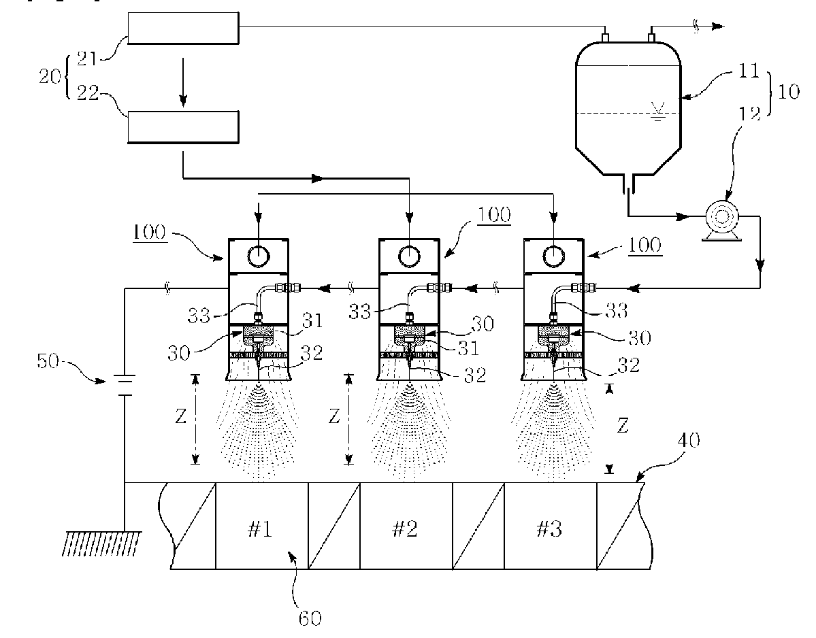
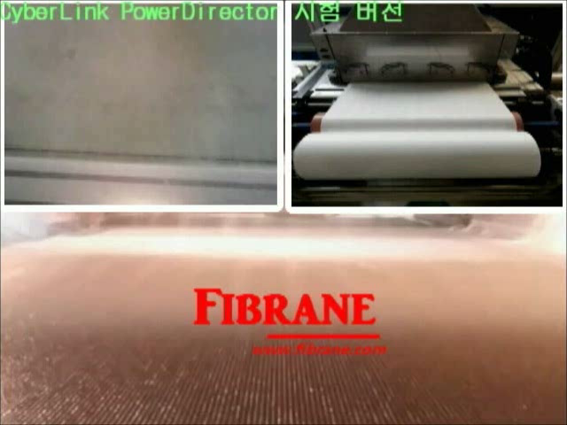
Re-modified Tech of AES Technology(Aero-dynamic E/S)
(World Top Productivity and Quality)
Patented Specially Designed Spin Beam
High Efficiency Electric Discharge Configuration
Precision Aerodynamic Flow Control – Laminar Flow
Post Spinning Carrier Recovery System
Post Spinning High Speed Web Handling System
*

Slide 26
Distinctiveness of AES(Aerodynamic E-Spinning) Tech.
Technology
World-wide Patent Coverage
Low deviation & Various Applications:
Air/Liquid Filters, Sports Wear, Bio-medical, Battery Separator, etc.
Productivity
Unprecedented Mass Production Productivity - Demostrated
500~1,000% Increase vs. Competitive Technologies
Low Maintenance Cost
Quality
Process Control and Uniform Fiber Diameter(~ 1µm)
Up to 90% Porosity, High Surface Area(5~500 m²/g)
Various Polymers Applicable
*

Slide 27





Functions & Applications Of Bio Nano-Web (Sheet)
Maximized specific surface area
Characters of Nano-web
Materials as~
The lower diameter,
the more maximized specific surface area..
High performance Filter
Heat resistant battery separator
Protective clothes for chemical & bio industry
Minimized diameter
Cosmetics:Facial mask
Small & even pore
Bio mimetics
Flow of pores by nano-fibers is extremely complicated
Nano liquid Filter
Sound-insulations
High performance wipes
Medical (surgical suture,Hemostatic ,
Military
27

Slide 28
ex1)Future Bio-Nano-Filter:3-Layers.
PLA Spunbond+PLA M/B(no-charging)+Nano PLA(E-Spin:500nm)
Filter | section | M/B weight (No-charging) | E (%) | ↓Pressure Drop(mmaq) | S/B+M/B+(E/S)
Mask | Droplets KF-80 | 25 20 25~30 25 | 30~50 80 | 8 10(95LPM) | 30+20+(1~2) 40+25+(2)
 | KF-94 (KN-95) | 30~35 30 (substrate 40) | 94 | 12(95lpm) | 40+30+(3)
Automobile cabin | O.E.M A/S | 20~25 20 (substrats 60~70) | 65~95 | 0.9~1.0 32LPM | 60+20+(1~2)
 | For E-Car | 25 25 (substrats 60~70) | 95 | 1.0 | 70+25+(3)
Room-air purifier | HEPA | 25~30 30 (substrate 70) | 99.95 | 3.0 | 70+30+(3)
HVAC | Medium 65 85 95 | 15~20 15 20~25 20 25~35 25 (substrate60) | 65 85 95 | 0.6 0.8 1.0 | 60+15+(1~2) 60+20+(2) 60+25+(3)
HEPA | HEPA | wet-laid glass 30 (substrate 50+50) | 99.97 | 10 | 50+30+(5)+50 4 layers

Slide 29

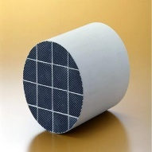
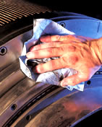
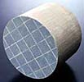
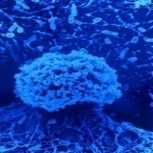

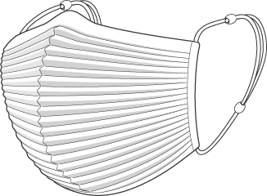
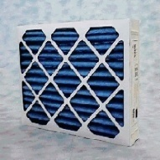
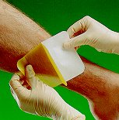
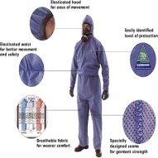


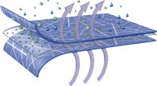
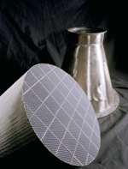
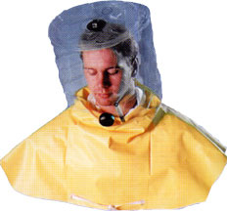

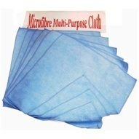
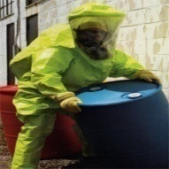
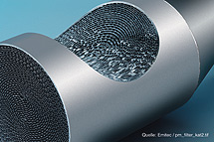
Various Applications.
Filters
Absorptions
Wipers
Protective
masks
Bio-filter
Medical. Cosmetics
sanitary naphkin
Wound bandage
미세먼지
세균
Nano-textile
Water-proof
Vent(for C.P)
quick-dry,absorption
물방울
Extreme-environmental materials(Insulation)
Chemical-protective
Military.
Energy-storage
화학물질
공기
Sound-proof & insulations
소리
29

Slide 30

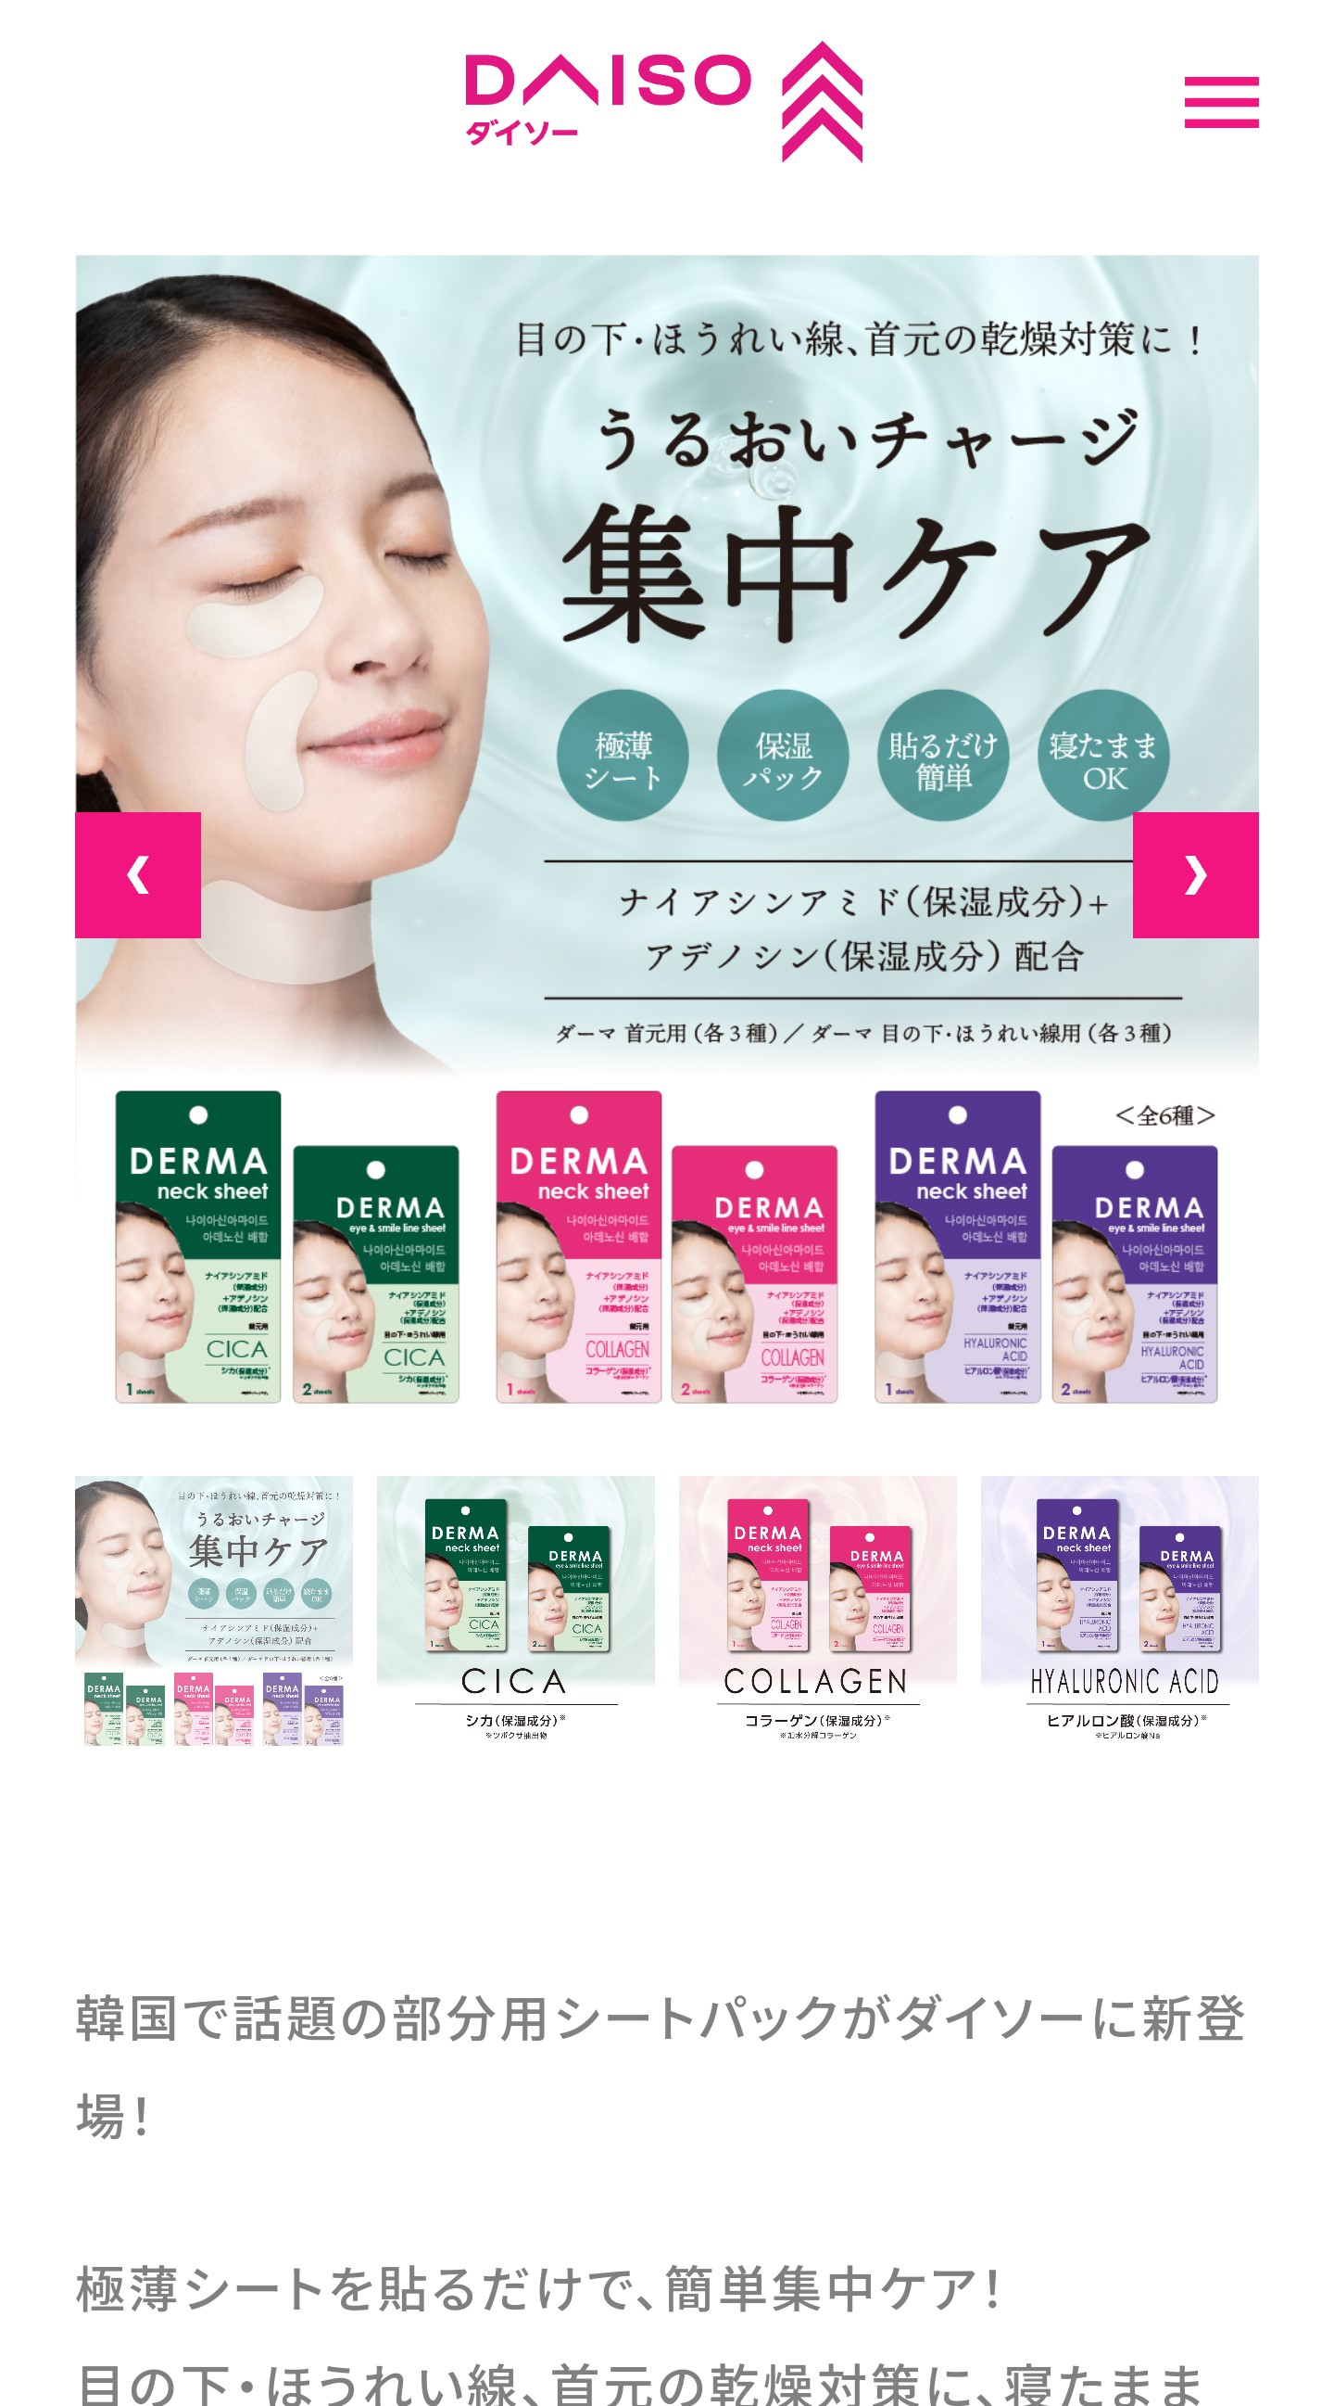
ex2) P.V.A(Collagen) nano fabrics-Patch & film
: Water-soluble Electro Blown Spinning

Slide 31
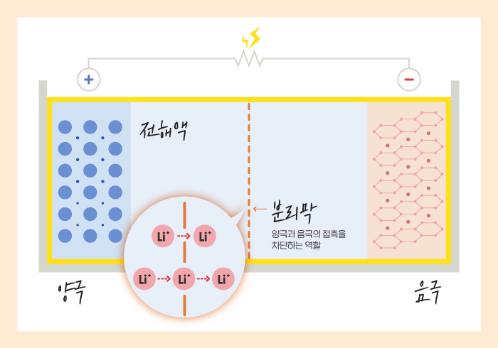
ex3)Heat-resistant Nano separator for E-Car
① Modification tech. of P.V.D.F or P. I polymers (Improvement of morecular weight & durability
② How to make ultra-thin nano-fabrics (under 16um).
(Super-caledering tech.)
③ How to increase the puncture strength) & minimize of deviation.
④ How to make a uniform ceramic coating technology.
how to keep the strength
⑤ How to maintain the electrolyte -absorbency
electrolyte
separator
anode
cathode
Main Property | Present | Target Spec.
Porosity | 30~50% | under 50%
pore size | 0.1~1μm | under 1μm
Thickness | 20μm | 16μm
Heat-resistancy (L.O.I) | 100~150℃ | over 160℃ (over 40)
Puncture Strength (ASTM D 5745) | 10N | over 14N

Slide 32
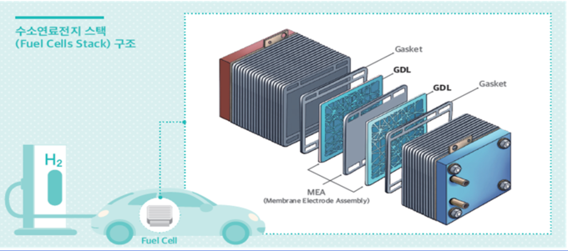
ex4)Gas diffusion layer for Hydrogen Fuel cell based on Carbon nanofiber fabrics
◦ How to make & laminate nano-layers by carbonization & stabilization of PAN polymer.
◦ 2nd ultra-high temp.sintering process after 1st stabilization
◦ Water-repellancy treatment & how to control ultra-thin thickness.(calendering)
◦ How to keep & control low surface resisrance.
◦ How to control uniform
Pore size
◦ How to keep high porosity.
Property | unit | PRESENT |  | Target
 |  | dometic | foreign
Porosity | % | 50 | 70 | 70~90
pore size | um | under 2 | 1 | under 1
surface resistance | 오옴/sq | 10 | 10 | under 10
Thickness | um | 100 | 50 | under 50
water repellancy |  |  | 5 degree | over 5 degree

Slide 33
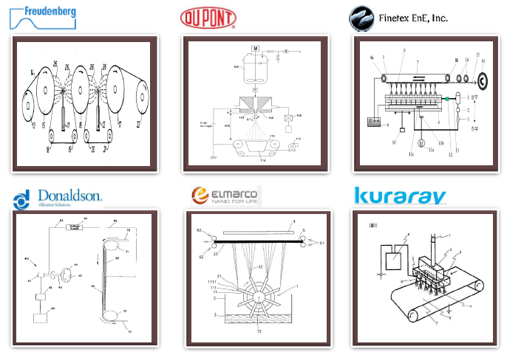
  Patents of Electro-Spinning
33

Slide 34
Worldwide Status of Nano-Fiber Tech.
Most Advanced & Commercialized
FT ENE Co.ltd –Toptech-Lemon(Multi-nozzle system)
  success on commercial production in 2005(P.U lining)-company sold out
Woo-Ri MNS
Amo Greentech.
Nam-Yang N.W.F Co.itd
Elmarco ltd.(Czech : Nano-spider)
  Supply facilities(up to 1.6m)
  Nano-spider technology.
  http://www.elmarco.com
  Newzealand : Revolution Fibers co.
Fibrane( Aerodynamic E-Spinning –LAB)
Success on electro-AES blown spinning in 2012
Mass-production with the biggest capacity
Transfer tec. & patent .
* U.S.A & Japan:
* China :
The others
Dupont-Cummins
  Donaldson co.
  H & V co. Etc…..
34

Slide 35





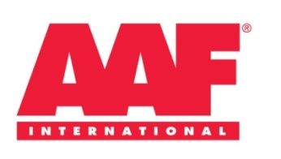








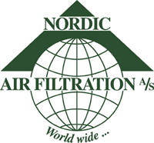


Bio-Nano Tech. For Air-Filters
  • Bio-HEPA Filter
  • Bio-Room Air cleaner (HEPA grade)
  • Bio- Fuel filter
  • Bio-Cabin Filter for E-Car
  • Bio-Liquid Filter
  • Filter Bag for dust- collector (hot gas)
  • Gas turbine filters
  • battery separator for E-Car.
  * Gas diffusion layer for H-Car
  • The others etc…
35

Slide 36
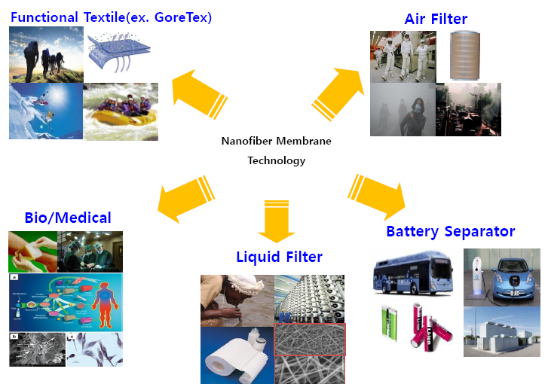
  Applications field
36

Slide 37
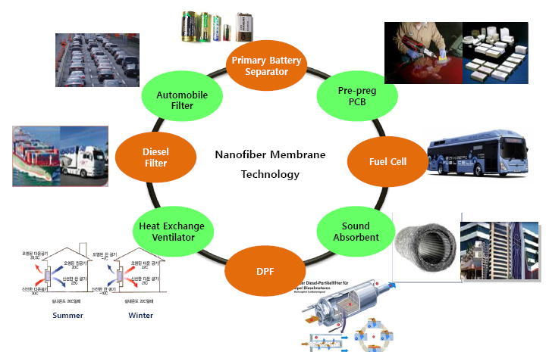
  Application field
37

Slide 38
Nano web Developement:
Essential Parameters in Process Control.
Article | Parameter & Problems!
Material | • Select the proper polymer • Viscosity, Density. • Conductivity, • Surface tension
Process | • Hydrostatic pressure • Electric potential (Voltage) • How to recover expensive solvent • Maximize the productivity
The Others Bio-Turnkey Solution | • Solution temp.• Humidity• Airflow & Velocity • How to minimize of deflection • PLA E-Spinning Turnkey Solution : 1MU$ (Width; 1.6m/min, speed: 20m/min) * PVA E-Spinning Solution:Software:0.5MU$.
38

Slide 39
Nano Fabrics : Commercialized Status
Company | Brand name | Application | Remarks
F Co. (Germany) | V. | Medium filter, Cabin filter | Electro spinning Polycarbonate (1000~2000nm) since 1970.
D co (USA) | Ultra-web | Medium filter, Gas-turbine filter Liquid filter | Nylon, since 1970
H co (England) | Nanos | HEPA filter, Liquid filter | PP, Technology from Nanofiber Tec., Inc (2000)
Korea |  | High-performance textile, Filters, Energy storage. Waterproof for membrane of Mobile Vent, Medical etc | PLA,PVA,Collagen,Chitosan etc. PVDF,P.U, Nylon 66, PVA, PAN, etc.The highest technics & biggest capacity in the world.
39

Slide 40
Capacity comparison of each Nano-Process
Articles | AES system (Electro blown spinning system) | D Co. (Multi nozzle) | L Co. & T Co (Multi-nozzle) | M co. (Multu-nozzle)
Productivity | 50~200Kg/day at a line (Nylon) (width:1.6m) | 5.0~7.0Kg/day at a line (pilot production scale) (width:1.0m,Nylon) | 8.0Kg/day(L) & 30Kg(T) At 1 lines (P.U & P.V.D.F) (width: 1.6m) | 10~12.0Kg/day at 1 line (P.U) (width:1.6m)
No.of holes/line | Under 1,000 | 8,000 | 9720(L) & 30,000(T) | 10,000
g/day/hole | 100 over | 0.5 | 0.8(F) & 3(T) | 1.0
Application | Air/Liquid filter Cosmetics.Medical, Battery separator etc.. | Air filter | Filter, Apparel Sanitary napkin | Mask filter energy storage, Apparel
Remarks. | • re-modified AES blown spin system • mass production | • • Low-productivity | • Multi nozzle • No. of nozzles is maximized to overcome The low-productivity | • Filters & Cosmetics.
40

Slide 41

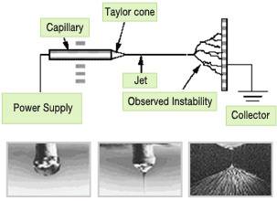
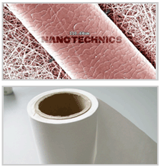

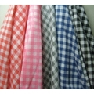
ex5) Nano Protective Fabrics
Direct A-E/Spinning of the Nano-web on Ultra thin Fabrics
Polymer
Solution
Ultra- Thin Textile
or
SMS
Electro
Spinning
Nanoweb
Sheet
Nanoweb
Sheet
Post-treatment
- Special Coating
- Print
- etc.
Nano-fabrics
Fabric or
Non-woven
No Bonding & Lamination tech.
41

Slide 42
Functionalities of Nano-Protective Fabrics
Articles | Nano-textile (SMS or Woven + nano Web) | Gore-Tex (woven +PTFE Film) | Remarks.
Moisture vapor permeability (g/m²/24h) | 4,000~10,000 | 5,000~10,000 | N/T : no-reduction after washing Gore-Tex : decrease after washing
Water proof (mmH₂O) | 10,000 | 10,000 | But, over 4,000 after 3-times washing
Absorption. (mm) | Increase 300% vs. woven | Almost same with woven. | C/Knit : 11/6 → 42/39 (PU) T/Suede : 44/5 → 100/100
Dryness. (g/202.5cm₂) | 1.15 | 2.53 | ※ Remained weight of 2-Layer fabric
Warmth. (%) | 22.5 | 17.2 | ※ 3-Layer fabric(+ Lining).
Lightness. (g/m²) | Web : 8~20 | Film + PU | ※ P.U weight 10~20 gsm in Hot melt Bonding.
42

Slide 43
Performance of NANO-Protective Fabrics
 | Moisture-vapor permeability | Water proof | absorption | dryness | warmth | lightness | Remarks. % application.
Nano Textile. | ◎ | ○ | ◎ (inside) | ◎ | ◎ | ◎ | •Excellent MVP, Ab, Dry. • wind-proof jacket with lightness. • Sports/Leisure in climbing. due to excellent Ab. & dryness) • Excellent Comfortness vs.Gore-Tex • Non-Swelling, Not noisy
Gore-Tex, Sympatex | ○ | ◎ | Χ | ○ | △ | △ | • Excellent water-proof. • Excellent the extreme environmental materials. • Excellent wind-proof jacket
※ ◎ : Excellent, ○ : Good, △ : Average, Χ : Bad
43

Slide 44













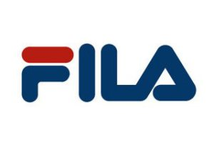


  Protective & Outdoor Clothes Markets.
44

Slide 45
Small differences make
big changes !
Thanks for listening !

